Slide 1



Slide 2

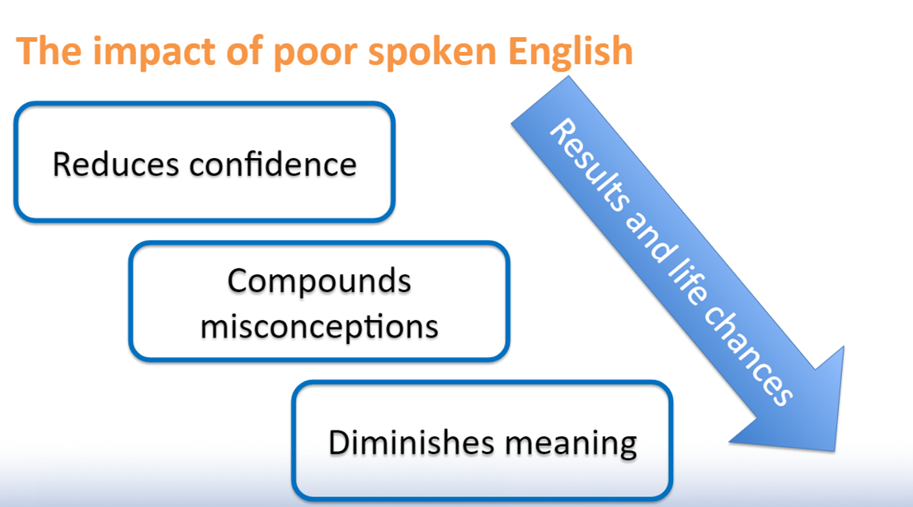
The worrying facts…

Slide 3

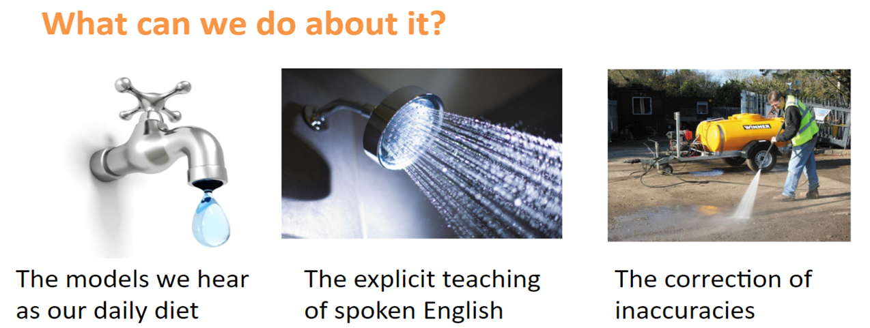
Improving children’s oracy

Slide 4
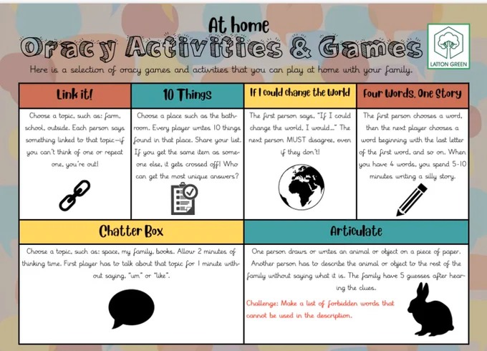
Keeping Oracy fun
Games and activities…
Follow the link on the ‘Oracy’ section of our school website for ideas and activities for improving your child’s oracy, or try one of these great games courtesy of Latton Green Primary School…

Slide 5
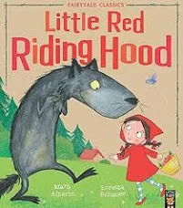


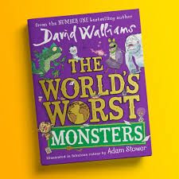
Stories
Can your child retell a story?
Does your child include the key characters and events?
How would they improve the story? What changes would they make and why?

Slide 6
Top ten oracy ideas to use at home
Discuss a news article - newspaper or on the news (i.e. Newsround).
Discuss a T.V. programme you have watched together.
Ask your child to interview a trusted adult about their life – possibly an older family member or neighbour.
Come up with a word of the day – challenge your child to use it in a conversation or in their writing.
Ask your child about their day.
Discuss the meaning of new vocabulary.
Supportively correct inaccuracies in your child’s spoken English.
Create a talk box at home.
Ask your child ‘Why?’
Play a game together and have your child explain the rules.

Slide 7
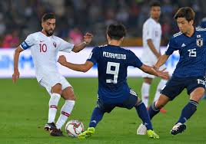
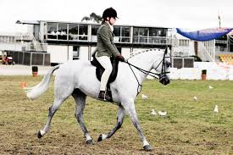

DiscusS, discusS, discusS!
The importance of questions…
Ask your child questions about their passions – football, gaming, fashion or watching films... children love to talk about what they enjoy!
The questions we ask our children can really shape their future. By asking them to explain what they have been doing when it is something they are passionate about, you will see their repertoire of language emerge.

Slide 8



